Slide 1
Capacitor and Inductor

Slide 2
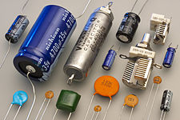
Capacitor
A capacitor (originally known as a condenser) is a passive two-terminal electrical component used to store energy electrostatically in an electric field.
An ideal capacitor is characterized by a single constant value for its capacitance. Capacitance is expressed as the ratio of the electric charge Q on each conductor to the potential difference V between them.
The SI unit of capacitance is the farad (F), which is equal to one coulomb per volt (1 C/V). Typical capacitance values range from about 1 pF (10−12 F) to about 1 mF (10−3 F).

Slide 3
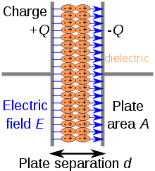

Capacitor: Theory of Operation
A capacitor consists of two conductors separated by a non-conductive region. The non-conductive region is called the dielectric. In simpler terms, the dielectric is just an electrical insulator. Examples of dielectric media are glass, air, paper, vacuum, and even a semiconductor depletion region chemically identical to the conductors.
A capacitor is assumed to be self-contained and isolated, with no netelectric charge and no influence from any external electric field. The conductors thus hold equal and opposite charges on their facing surfaces, and the dielectric develops an electric field.
An ideal capacitor is wholly characterized by a constant capacitance C, defined as the ratio of charge ±Q on each conductor to the voltage V between them

Slide 4

Capacitor: Theory of Operation
Because the conductors (or plates) are close together, the opposite charges on the conductors attract one another due to their electric fields, allowing the capacitor to store more charge for a given voltage than if the conductors were separated, giving the capacitor a large capacitance.
Sometimes charge build-up affects the capacitor mechanically, causing its capacitance to vary. In this case, capacitance is defined in terms of incremental changes:

